Slide 1


DATA ANALYSIS

Slide 2

Exploratory Data Analysis ( EDA )
Exploratory Data Analysis refers to the critical process of performing initial investigations on data so as to discover patterns, to spot anomalies,to test hypotheses and to check assumptions with the help of summary statistics and graphical representations.
In statistics, exploratory data analysis (EDA) is an approach of analyzing data sets to summarize their main characteristics, often using statistical graphics and other data visualization methods. A statistical model can be used or not, but primarily EDA is for seeing what the data can tell us beyond the formal modeling and thereby contrasts traditional hypothesis testing. Exploratory data analysis has been promoted by John Tukey since 1970 to encourage statisticians to explore the data, and possibly formulate hypotheses that could lead to new data collection and experiments. EDA is different from initial data analysis (IDA),which focuses more narrowly on checking assumptions required for model fitting and hypothesis testing, and handling missing values and making transformations of variables as needed. EDA encompasses IDA.

Slide 3
Steps involved in EDA :-
● Data Analysis (Data Pre-Processing, Cleaning and Manipulation).
● Data Visualisation (Visualize relationships in data using different types of plots).

Slide 4

Indian Premier League ( IPL )
The Indian Premier League (IPL), also known as TATA IPL for sponsorship reasons, is a men's T20 franchise cricket league of India. It is annually contested by ten teams based out of seven Indian cities and three Indian states. The league was founded by the Board of Control for Cricket in India (BCCI) in 2007. Brijesh Patel is the incumbent chairman of IPL. It is usually held annually in summer across India between March to May and has an exclusive window in the ICC Future Tours Programme.
Indian Premier League(IPL) is a professional Twenty 20 cricket league in India contested during March or April and May of every year by eight teams representing eight different cities in India.The league was founded by the Board of Control for Cricket in India (BCCI) in 2008.
The data set that is going to be used is 'IPL Matches Dataset'. It contains IPL matches data from 2008 to 2019

Slide 5
Questions
Number of matches played in each IPL season.
Toss Winner(Team winning most tosses) across all IPL seasons.
Toss Decision(Bat or to Field)in each IPL seasons.
Toss Decision Percentage across all IPL seasons.
Top 10 Most frequently used stadiums across all IPL seasons
Top 7 Cities that hosted most IPL matches across all seasons

Slide 6
Top 5 Umpire1 who were to evaluate different matches across all IPL Seasons.
Top 5 Team that won the most matches across all the IPL Seasons.
Top 8 Percentage distribution of different winning teams across all the IPL Seasons.
Top 7 players with most Player of the Match awards.
Win Toss to the game.
Win by Runs(How many times each IPL team has won the match by runs).
Win by Wickets(How many time search IPL team has won the match by wickets).

Slide 7

INSIGHTS

Slide 8
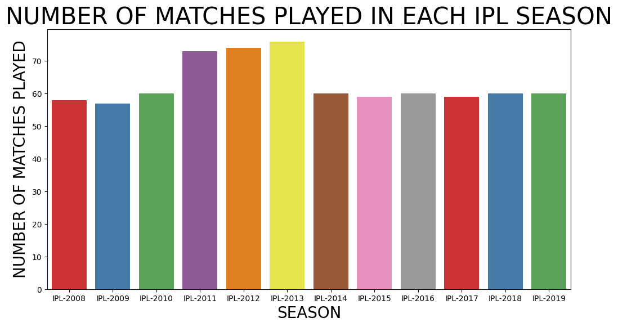
Number of Matches Played in Each IPL Season
There were most matches played in IPL-2013.
The Three Seasons in which the most matches were played are IPL-2011, IPL-2012 and IPL-2013.

Slide 9
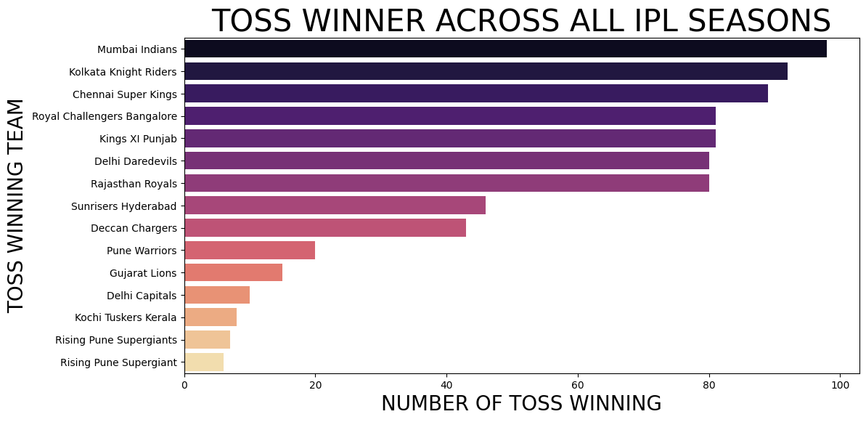
Toss Winner (Team winning most tosses) across all IPL seasons
Mumbai Indians Team was winning most of the toss across all IPL Seasons.
The Three Teams whose win most of the toss across all IPL Seasons were Mumbai Indians, Kolkata Knight Riders, Chennai Super Kings.

Slide 10
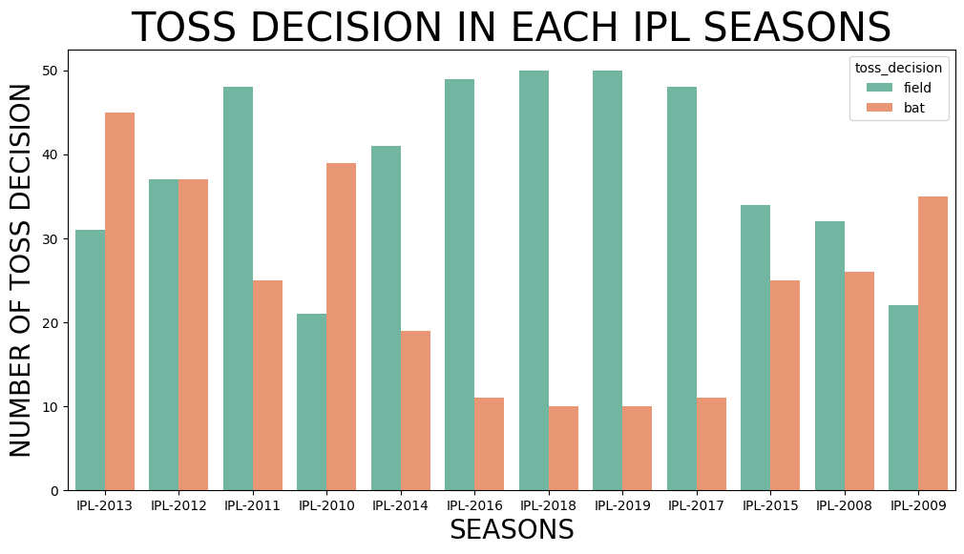
Toss Decision(Bat or to Field) in each IPL season
There were 463 decisions taken of Field
There were 293 decisions taken of Bat.

Slide 11
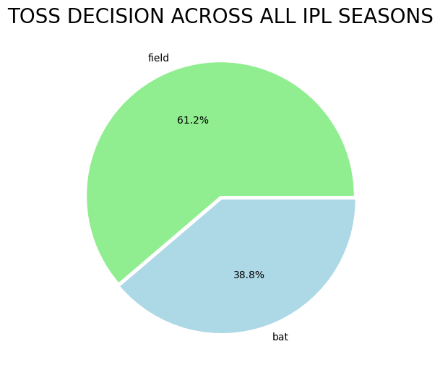
Toss Decision Percentage across all IPL seasons.
There is 61.20% toss decision taken in all IPL Seasons.
There is 38.80% toss decision taken in all IPL Seasons.

Slide 12
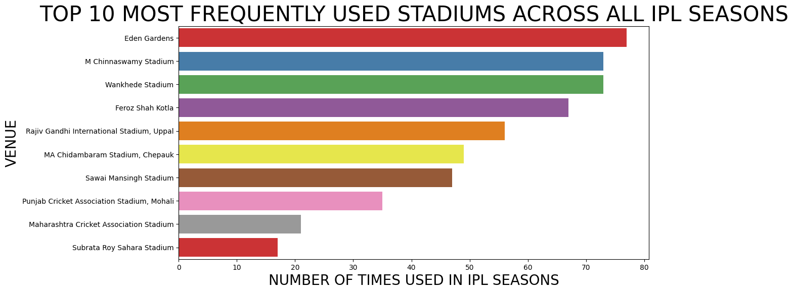
Top 10 Most frequently used stadiums across all IPL seasons.
The most frequently used stadium was Eden Gardens in all IPL Seasons.
The Three most frequently used stadium were Eden Gardens, M Chinnaswamy Stadium, Wankhede Stadium in all IPL Seasons.

Slide 13
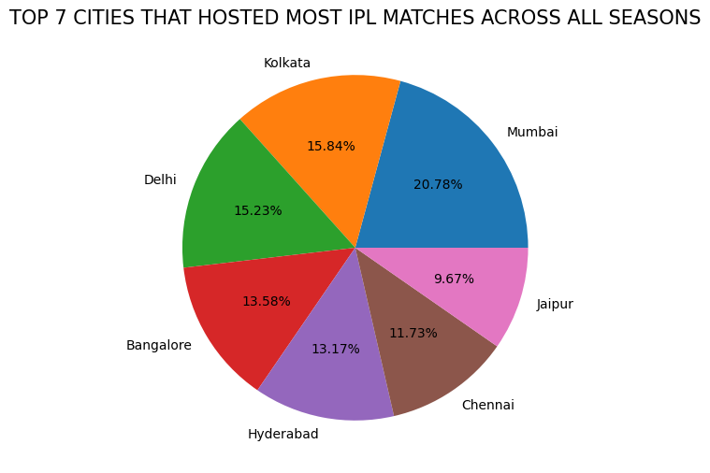
City that hosted most IPL matches across all seasons (Top 7 Cities)
Mumbai is the cities that hosted most IPL matches across all Seasons.
The Three cities that hosted most IPL matches across all Seasons were Mumbai, Kolkata, Delhi.

Slide 14
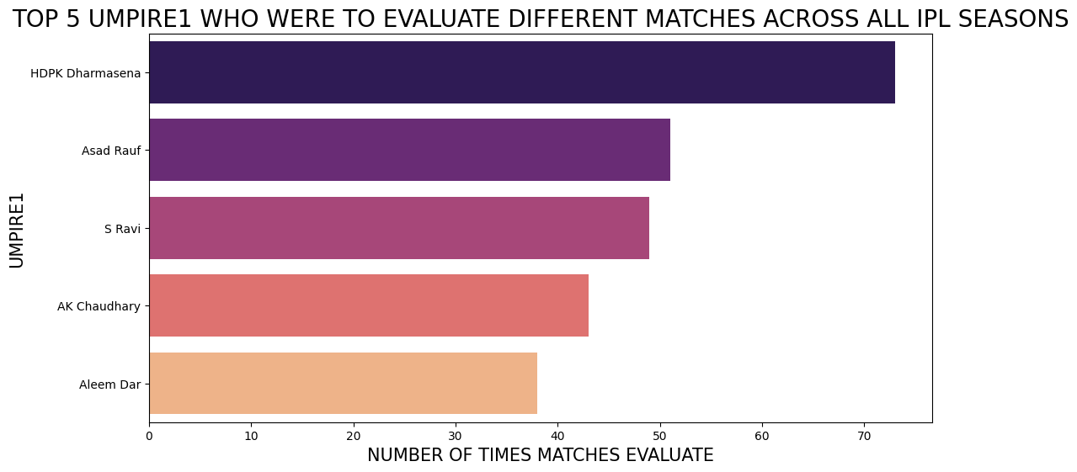
Top 5 Umpire1 who were to evaluate different matches across all IPL Seasons.
HDPK Dharmasena was the Umpire that evaluate matches across all IPL Seasons.
The Three Upmire that evaluate matches across all IPL Seasons were HDPK Dharmasena, Asad Rauf and S Ravi.

Slide 15
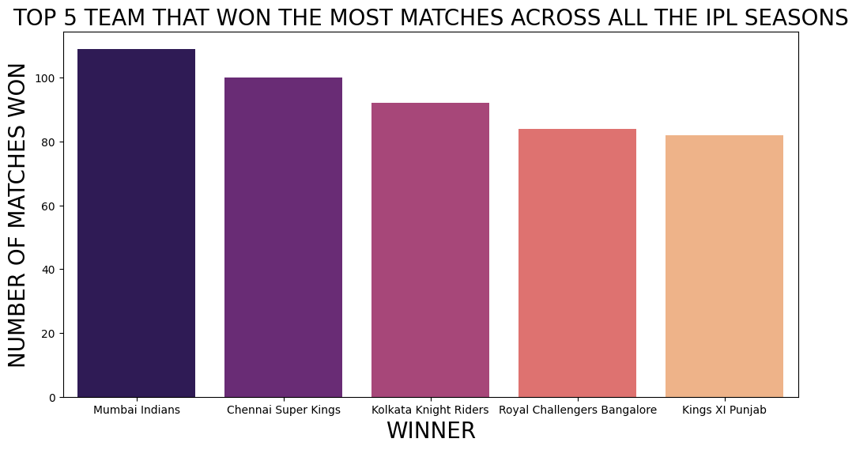
Top 5 Team that won the most matches across all the IPL Seasons.
Mumbai Indians Team that won most of the matches in all IPL Season.
The Three teams that won most matches were Mumbai Indians(who won 109 matches), Chennai Super Kings(who won 100 matches), Kolkata Knight Riders(who won 92 matches).

Slide 16
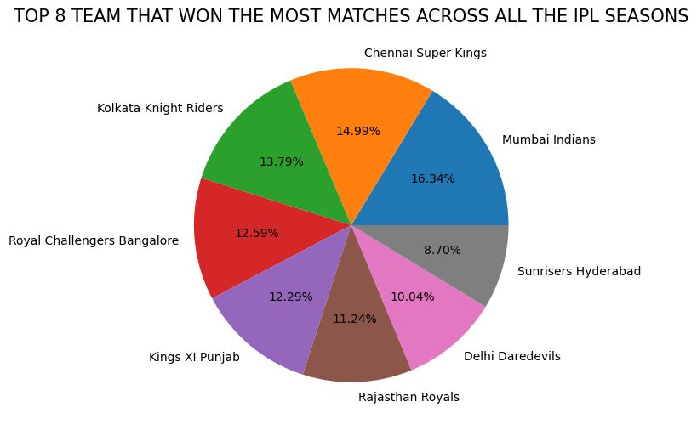
Top 8 Percentage distribution of different winning teams across all the IPL Seasons.
Mumbai Indians Team that won most of the matches in all IPL Season.
The Three teams that won most matches were Mumbai Indians(who won 16.34% matches), Chennai Super Kings(who won 14.99% matches), Kolkata Knight Riders(who won 13.79% matches).

Slide 17
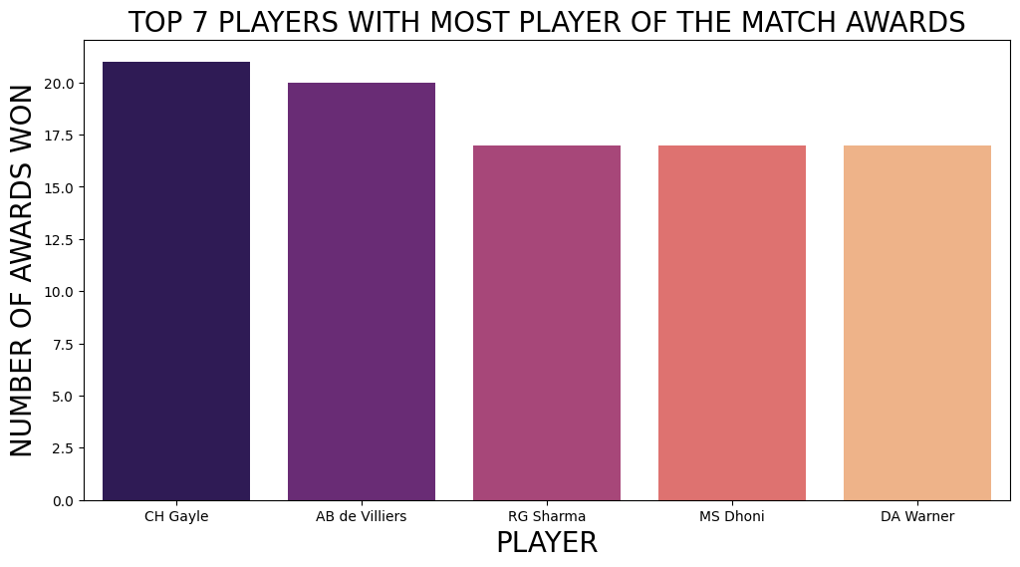
Top 7 players with most Player of the Match awards.
CH Gayle won the most matches awards.
The Three PLayers that won the most matches award are CH Gayle, AB de Villier, and RG Sharma.

Slide 18
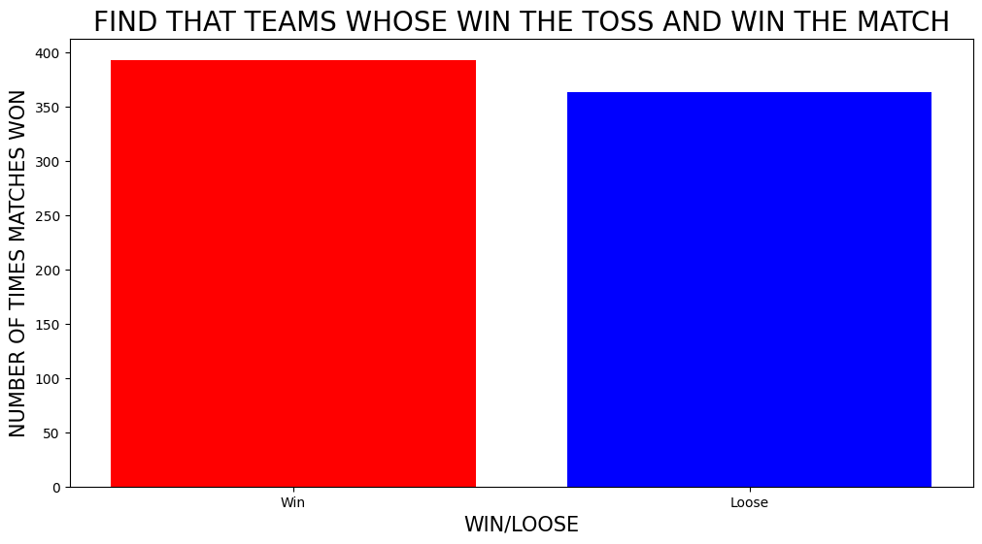
Find that teams whose win the toss and win the Match
Across all the IPL seasons in 393 matches, the toss winner emerged as the match winner as well and in 363 matches the toss winner lost the match.

Slide 19
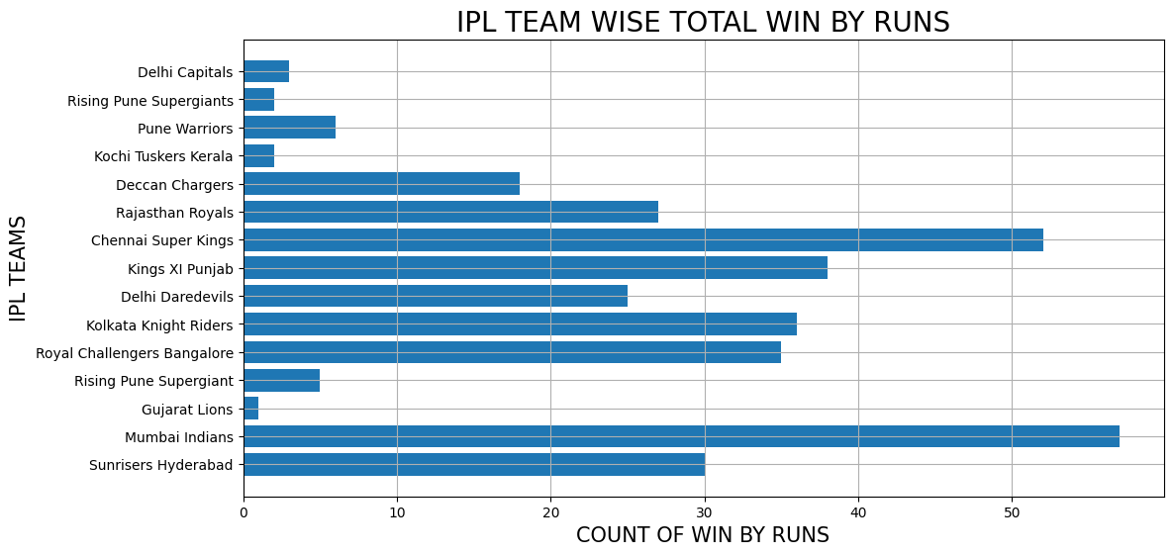
Win by Runs(How many times each IPL team has won the match by runs).
MI has won most of the matches by winning by Run
Followed by Chennai Super Kings

Slide 20
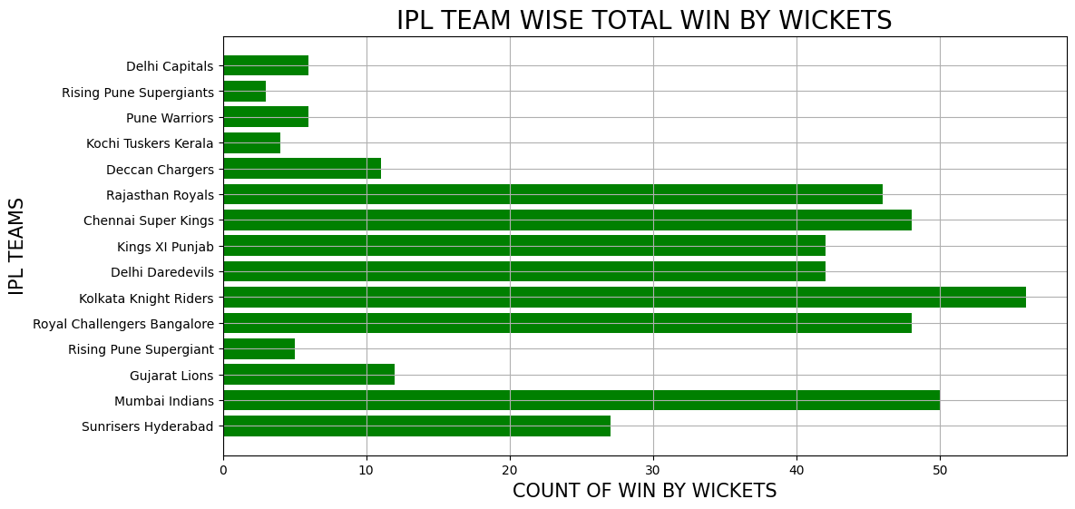
Win by Wickets(How many time search IPL team has won the match by wickets).
Kolkata Knight Riders have won most of the IPL matches based on win by wickets
Followed by Mumbai Indians and Chennai Super Kings

Slide 21
Team Wise Performance

Slide 22
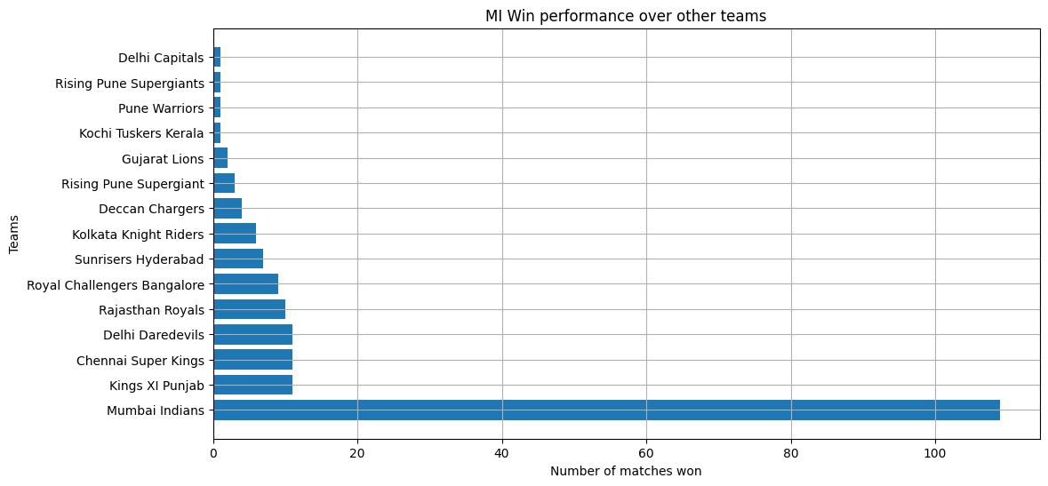
Mumbai Indians ( MI )
MI has won 109 times when compared to the losses against it.

Slide 23
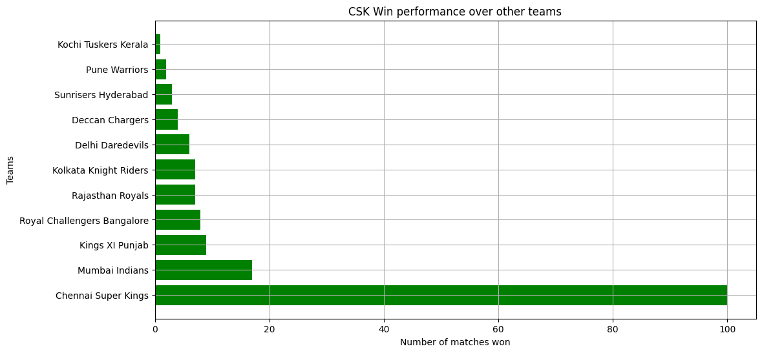
Chennai Super Kings ( CSK )
CSK has won 100 times when compared to the losses against it.

Slide 24

Data Analysis Conclusion of IPL Dataset
Number of matches played in each IPL season
There were most matches played in IPL-2013.
The Three Seasons in which the most matches were played are IPL-2011, IPL-2012 and IPL-2013.
Toss Winner (Team winning most tosses) across all IPL seasons
Mumbai Indians Team was winning most of the toss across all IPL Seasons.
The Three Teams whose win most of the toss across all IPL Seasons were Mumbai Indians, Kolkata Knight Riders, Chennai Super Kings.
Toss Decision(Bat or to Field) in each IPL season
There were 463 decisions taken of Field
There were 293 decisions taken of Bat.

Slide 25
Toss Decision Percentage across all IPL seasons.
There is 61.20% toss decision taken in all IPL Seasons.
There is 38.80% toss decision taken in all IPL Seasons.
Top 10 Most frequently used stadiums across all IPL seasons
The most frequently used stadium was Eden Gardens in all IPL Seasons.
The Three most frequently used stadium were Eden Gardens, M Chinnaswamy Stadium, Wankhede Stadium in all IPL Seasons.
City that hosted most IPL matches across all seasons (Top 7 Cities)
Mumbai is the cities that hosted most IPL matches across all Seasons.
The Three cities that hosted most IPL matches across all Seasons were Mumbai, Kolkata, Delhi.
Top 5 Umpire1 who were to evaluate different matches across all IPL Seasons.
HDPK Dharmasena was the Umpire that evaluate matches across all IPL Seasons.
The Three Upmire that evaluate matches across all IPL Seasons were HDPK Dharmasena, Asad Rauf and S Ravi.

Slide 26
Top 5 Team that won the most matches across all the IPL Seasons.
Mumbai Indians Team that won most of the matches in all IPL Season.
The Three teams that won most matches were Mumbai Indians(who won 109 matches), Chennai Super Kings(who won 100 matches), Kolkata Knight Riders(who won 92 matches).
Top 8 Percentage distribution of different winning teams across all the IPL Seasons.
Mumbai Indians Team that won most of the matches in all IPL Season.
The Three teams that won most matches were Mumbai Indians(who won 16.34% matches), Chennai Super Kings(who won 14.99% matches), Kolkata Knight Riders(who won 13.79% matches).
Top 7 players with most Player of the Match awards.
CH Gayle won the most matches awards.
The Three Players that won the most matches award are CH Gayle, AB de Villier, and RG Sharma.

Slide 27
Win Toss to game.
Across all the IPL seasons in 393 matches, the toss winner emerged as the match winner as well and in 363 matches the toss winner lost the match.
Win by Runs(How many times each IPL team has won the match by runs).
MI has won most of the matches by winning by Run, followed by Chennai Super Kings
Win by Wickets(How many times each IPL team has won the match by wickets).
Kolkata Knight Riders have won most of the IPL matches by wickets, followed by Mumbai Indians and Chennai Super Kings

Slide 28
Team Wise Analysis
Mumbai Indians
MI has won 109 times when compared to the losses against it.
Chennai Super Kings
CSK has won 100 times when compared to the losses against it.

Slide 29
Thank You!

